Slide 1
Department of Electrical and Electronics Engineering Second Year (2022-2026) Batch - II Semester 18EEP202L-MINOR PROJECT
FINAL REVIEW
Short circuit Protection system for Electric Vehicle Safety
PRESENTED BY: GUIDED BY:
RAM PRAKASH S SAPREENA S
SRINIDHI B
(927622BEE086) (927622BEE099) (927622BEE114)
B.SHARMILADEVI M.E., ASSISTANT PROFESSOR, DEPARTMENT OF EEE, MKCE.
1

Slide 2
LIST OF CONTENTS
Abstract
Introduction
Description
Block Diagram
Components used
Hardware Components
Working
Cost Estimation
Conclusion

Slide 3
ABSTRACT
We often come across news of EVs catching fire or batteries overheating and exploding. To address this, our Electric Vehicle Safety project focuses on protecting the motor and battery from short circuits using relays in electric vehicles. The world relies heavily on crude oil, such as petrol and diesel, for vehicle energy. However, these fossil fuels are limited and not sustainable for the long term. That's why there is growing interest in finding solutions through electrical power.
Electric vehicles (EVS) are gaining popularity as an alternative to traditional fuel-powered cars. However, EVS face challenges with various components, including motor malfunctions, battery overheating, power losses, and coil heating.
4

Slide 4
INTRODUCTION
The short circuit protection system prevents excessive current flowing through the circuit that stops the operation when the power supply of line or load is short-circuited due to some kind of abnormality.Electric vehicles (EVs) have become increasingly popular due to their environmental benefits, lower operating costs, and technological advances. However, like all electric systems, EVs are susceptible to short circuits—faults that occur when there is an unintended, low-resistance connection between two points in an electric circuit, causing excessive current flow. In the context of EVs, short circuits are particularly concerning due to the high-voltage battery systems and advanced electronics these vehicles rely on. Ensuring safety against short circuits is, therefore, essential for protecting passengers, preventing damage to critical components, and maintaining overall vehicle reliability.
5

Slide 5
DESCRIPTION
Short circuit protection system can play a vital role to prevent excessive current flow.It can detect overcurrent situations and instantly interrrupts the circuit to prevent damage or hazards.Enhance the design and insulation of electrical components to minimize the risk of short circuits from electric vehicles.This will prevent injury to personnal, minimize damage to system components, and limit the extent and duration of service interruption during equipment failures, overload or short circuit conditions.

Slide 6
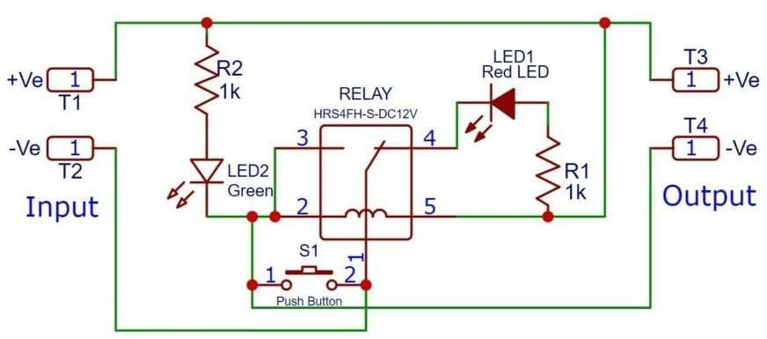
BLOCK DIAGRAM

Slide 7
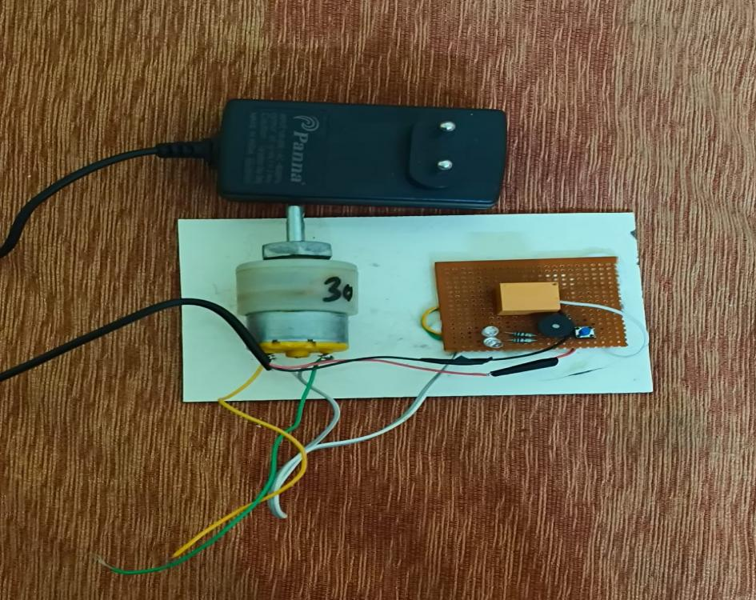
HARDWARE KIT

Slide 8
COMPONENTS USED
Microcontroller
12 Volt DC Motor
Voltage Sensor
LED's
12 Volt Relay
Piezo Buzzer
Resistor
Other Materials

Slide 9
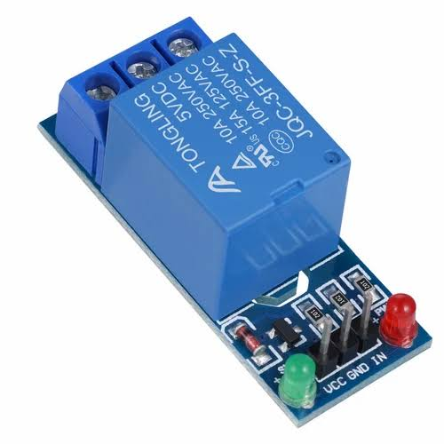
HARDWARE COMPONENTS
RELAY
The primary purpose of a relay is to protect the electrical system from too high
of a voltage or current, allowing the safe operation of any equipment it connects to.
They are commonly found in a variety of applications, from commercial and industrial
uses to home and consumer products. Relays control one electrical circuit by opening
and closing contacts in another circuit. There is an open contact when the relay is not
Energized.

Slide 10
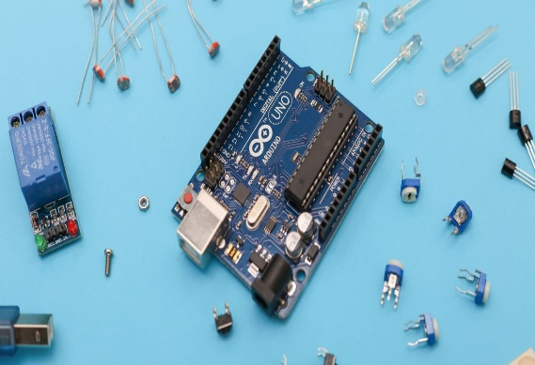
Arduino Uno is open source microcontroller board that can be integrated into a variety of electronics project. This board can be interfaced with other Arduino boards, Arduino shields and can control relays, LED’s and motors as an output. Arduino boards are able to read inputs light in a sensor, a finger on a button, and turn it into an output activating a motor, turning on an LED, publishing something online. It consists of various pins, which makes it more compatible and can be used to connect different electronic components. It is the most popular and widely used development board.
MICROCONTROLLER

Slide 11
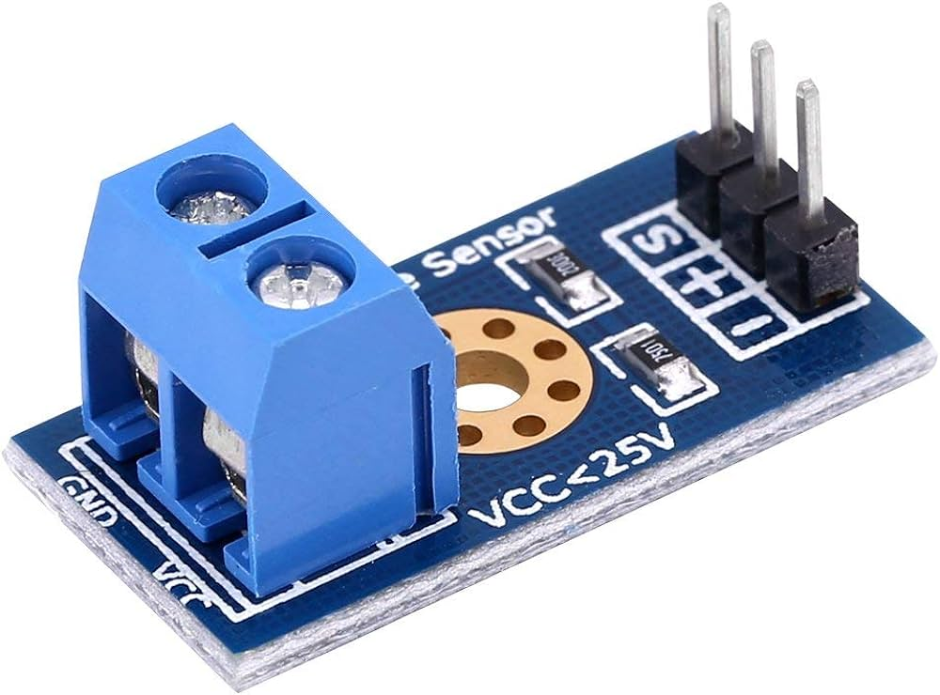
VOLTAGE SENSOR
A voltage sensor is a device that measures voltage. Voltage sensors can measure the voltage in various ways, from measuring high voltages to detecting low current levels. These devices are essential for many applications, including industrial controls and power systems.

Slide 12
WORKING
In step 1 of the operation, the relay circuit is normally open and a red LED glows when we connect a power source to the input terminal of the circuit.
when we press the bell push button, a coil of the relay becomes active and it switches from normally closed to normally open contact. In this condition Green LED and motor are ON and start to operate i.e. the vehicle starts to operate.

Slide 13
WORKING
Here manually short-circuited the terminals of the motor to understand the short circuit condition in EV the voltage across the motor is led to zero so the relay becomes discharged because both the relay and motor are connected in parallel.
Finally, if the relay is discharged then Red LED and buzzer both are ON and thus motor and battery
both are separated and protected.

Slide 14
COST ESTIMATION
S.NO | COMPONENTS | QUANTITY | COST
1 | DC Motor(12 V DC) | 1 | 200
2 | Relay(12 V) | 1 | 150
3 | Voltage Sensor | 1 | 200
4 | Resistance | 2 | 30
5 | LED's | 2 | 20
6 | Connecting Leads | Required | 50
7 | Microcontroller | 1 | 150
8 | PCB Board | 1 | 200
9 | Buzzer | 1 | 150
 |  | TOTAL | 1150

Slide 15
CONCLUSION
The short circuit protection system for electric vehicles ensures the safety and reliability of the vehicle's electrical system. By quickly detecting and isolating short circuits, it prevents damage to components and reduces the risk of fire or electrical hazards. With its robust design and swift response, the system contributes to the overall safety and performance of electric vehicles, providing peace of mind for both drivers and manufacturers.
Short circuit protection system plays a vital role in preventing excessive current flow. It detects the overcurrent situations and instantly interrupts the circuit to prevent damage or hazards and protect the motor and battery from short circuit. We are also gaining the popularity as an alternative to traditional fuel powdered electric vehicles.

Slide 16

11/17/2023
SECOND YEAR ZEROTH REVIEW
12

